Slide 1
Lecture XIII: Galaxy Surveys, Part 1
Physics 8803
April 10, 2019

Slide 2
Contents
Theory of galaxy clustering
Observational aspects of optical surveys

Slide 3
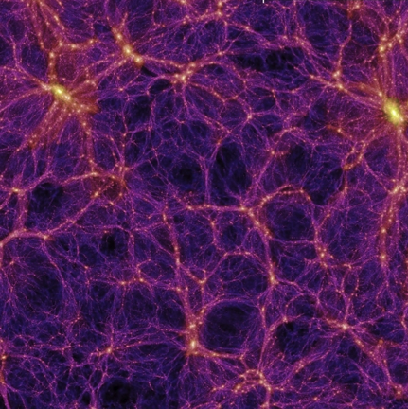
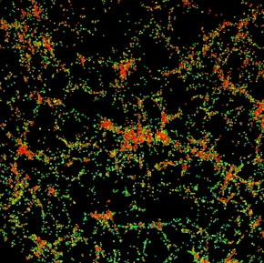
The “biasing” problem
Theory gives “clean” predictions for the matter distribution …
… but we (mostly) see the galaxies: the most complicated regions of the Universe!
Simulation (Springel et al. 2005)
Data (SDSS)

Slide 4
Biasing theory
Long wavelength
field
Full field
x
“Long wavelength” field = smoothed on a scale that is linear.
For Gaussian initial conditions, δ_{Long} and δ_{Short} are independent
(different Fourier modes, zero covariance).

Slide 5
Biasing theory
Imagine a region of space goes non-linear and collapses if the linear theory density perturbation exceeds some threshold δ_{crit} of order unity (1.69 in spherical collapse model).
Then some probability for collapse at mass scale M:
Collapse probability for halos of mass M depends on:
Standard deviation at mass scale M, σ(M) (smaller for larger M)
Long-wavelength overdensity, δ_{Long}.
See: Press & Schechter (1974), Bond et al. (1991), etc.

Slide 6
Biasing theory
δ_{crit}
x

Slide 7
Predictions
Cosmic mean abundance of halos:
decreases as a function of M (tail of Gaussian, width σ(M)).
Local overdensity of halos:
b(M) = bias factor, increases as a function of M
Simple analytic formulae give guidance, but need simulations for accurate results.

Slide 8
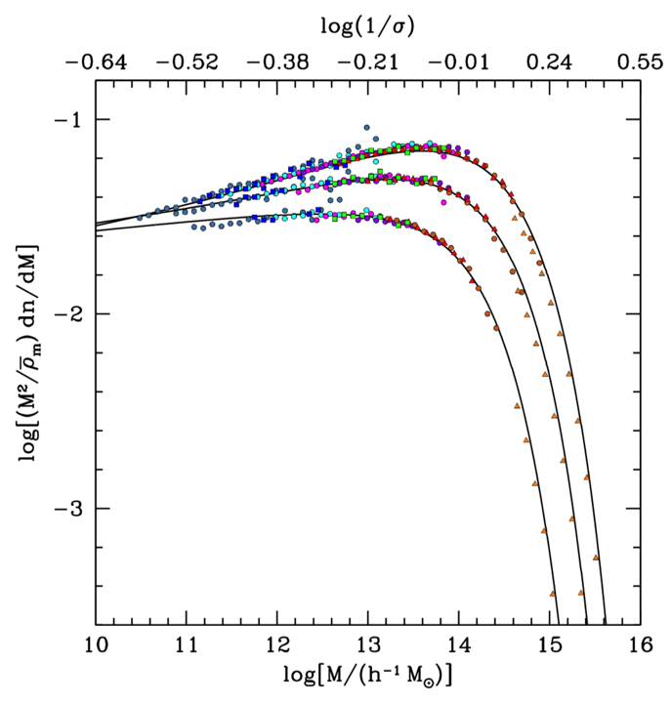
Halo mass function
from simulations
(Tinker et al. 2008)
Very massive halos are rare (small σ). Can use their abundance as a measure of σ(M) if mass can be measured.
Probability of a particle being in a halo of mass M per ∆(ln M)
Halo defined by overdensity of
200 (top), 800, and 3200 (bottom)
z = 0

Slide 9
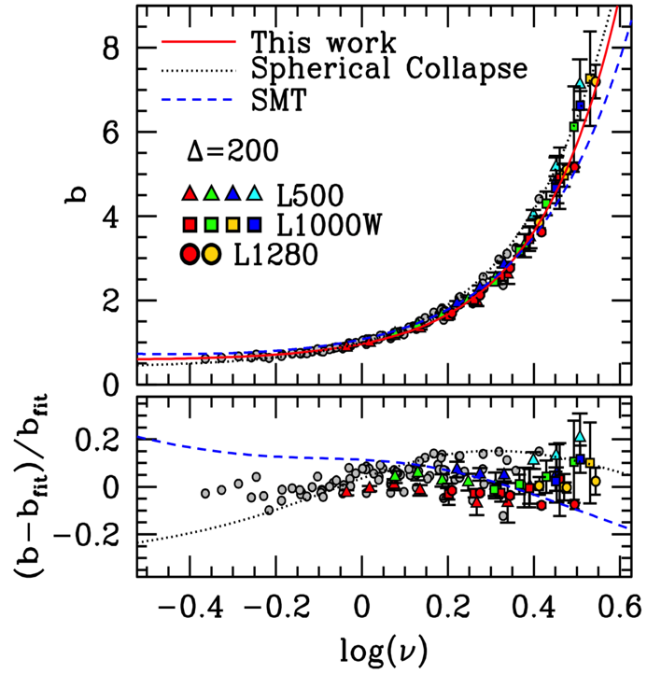
Bias of dark matter halos
in N-body simulations
Tinker et al. (2009)
Most massive halos are most biased!
low M
high M

Slide 10
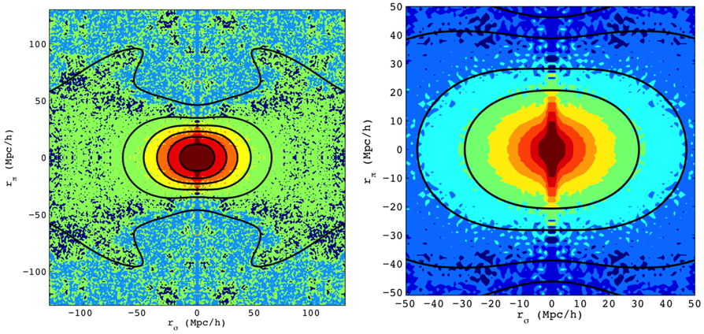
Redshift space distortions
Galaxy correlation function is anisotropic in observed space, since the “observed” position of a galaxy depends on its velocity.
(distant observer approximation)
Reid et al. 2012

Slide 11
Observational Aspects
Imaging surveys:
Can go fainter/get more objects in a given amount of telescope time
Colors only, not “real” redshifts (but photo-z’s)
But morphological information (e.g., shapes for weak lensing)
Spectroscopic surveys:
Most precise redshifts
Spectral diagnostics of galaxies (line widths, ratios of intensities …)
But very expensive and sample sizes are smaller
(Usually) “target” objects identified in imaging surveys

Slide 12
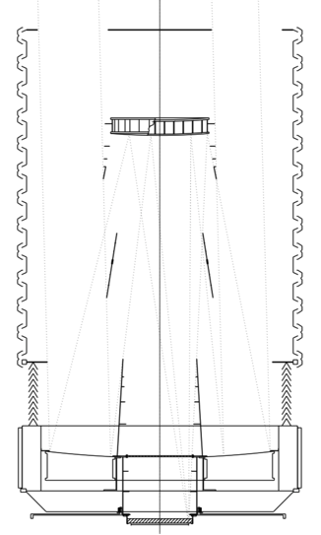
Imaging Surveys
Use optical telescope – may be:
1 mirror + multi-lens corrector (DECam, HSC)
2 mirror + smaller corrector (SDSS)
3 mirror, no refractive elements with substantial power (LSST, WFIRST, Euclid Visible channel)
Choice often based on desired pixel scale and engineering considerations.
Detectors in focal plane – usually CCDs in visible (HgCdTe hybrid detectors in NIR)
SDSS telescope (Gunn et al. 2006)
M2
baffles
M1
Focal plane

Slide 13
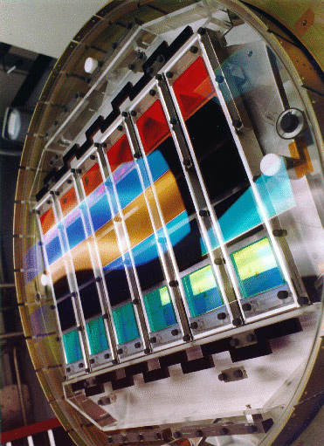
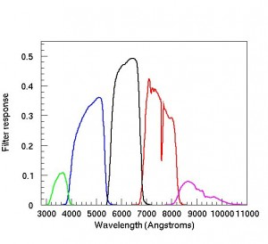
Cameras
Multi-layer interference filters may be fixed (e.g., SDSS at left) or on a mechanical filter changer or wheel (most surveys)
r
g
i
u
z
SDSS Mosaic Camera

Slide 14
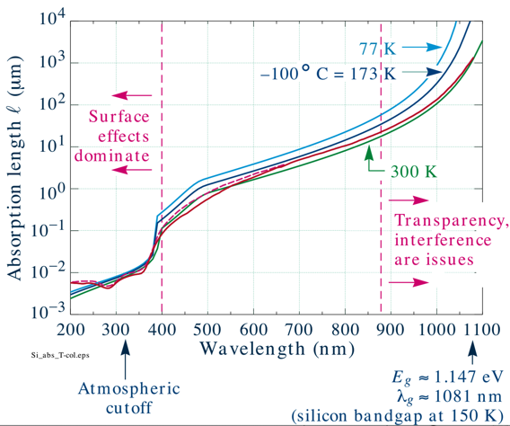
Silicon CCDs
Incoming photon, hν>1.1 eV
→ electron-hole pair
Electron (usually) collected in “pixel” (potential minimum)
Transferred to amplifier
Historically sensitive to λ ~ 800 nm, now ~1000 nm (“thick” CCDs)
Parallel transfer
Serial transfer
Pixel
(amplifier)
Groom et al. (1999)

Slide 15
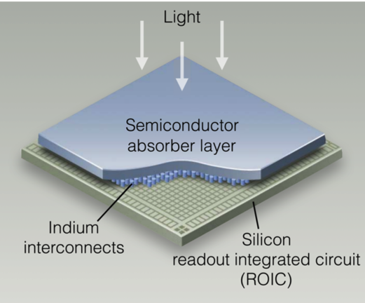
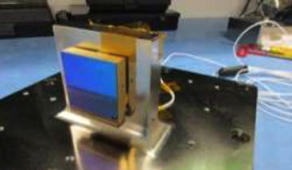
Infrared detector arrays
Silicon is not a good light sensing material at wavelengths > 1.06 μm
Usually use a photodiode array in a narrow-gap semiconductor, and connect to a silicon readout circuit
Material of choice for NIR astronomy is mercury cadmium telluride (Hg_{1-x}Cd_{x}Te)
4088 pixels
(4 cm)
(Hg_{1-x}Cd_{x}Te)
(1 per pixel!)
(Modified figure by Bernie Rauscher, based on a similar figure by Jim Beletic)
Detector array on vibration fixture
(WFIRST IR Technology Milestone Report #5)

Slide 16
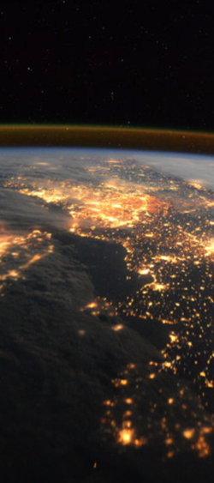
Working in the Near Infrared
airglow
Background [photons / m² / s / arcsec² / Δ ln λ]
Ground background
(1% resolution)
Thermal background
(270 K telescope)
Space background
Wavelength [nm]
ESA/NASA
visible
near infared

Slide 17
Fiber Spectrographs
Used for most large ground-based surveys: SDSS, BOSS/eBOSS, DESI, PFS, 4MOST, …
“Targets” are identified from a prior imaging survey
Every instrument is unique, but generally have:
Focal plane – feed light into fibers, placed at positions of targets (old: plug plate with holes; in the future, with robotic positioners)
Fiber run to spectrograph entrance slit – here fibers are formatted in a vertical column
Collimator to put image of fibers at ∞ (light from 1 fiber is all parallel)
Diffraction gratings to spread light horizontally
(optional) Dichroic(s) to split light into wavelength bands (e.g., blue vs. red channels) to go into optimized cameras
Camera (set to image source at ∞)
Detectors (in camera focal plane)

Slide 18
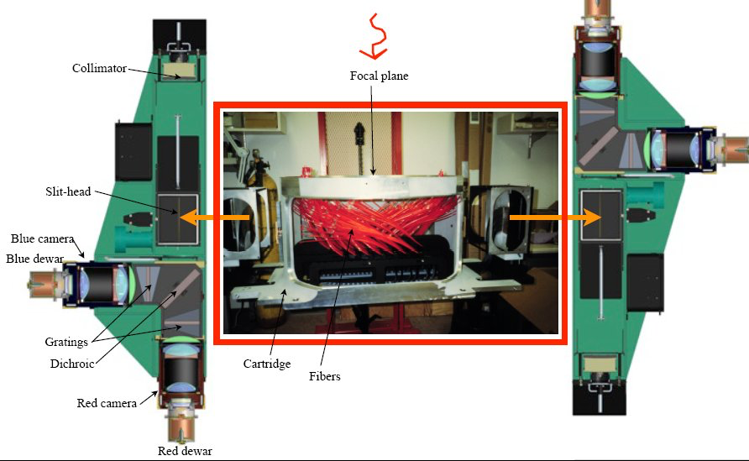
BOSS Spectrograph
SDSS

Slide 19
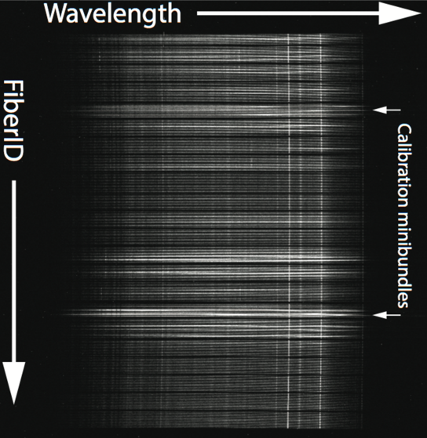
“2D” Spectrograph Data
… example from MaNGA survey
(Law et al. 2016)

Slide 20
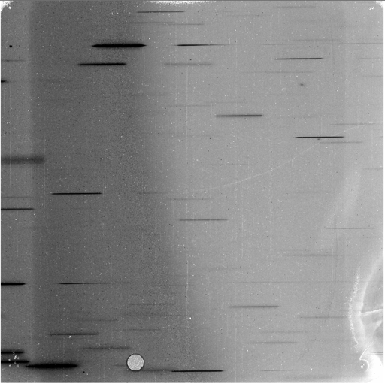
Alternative – Slitless Spectroscopy
Put a grating in front of the detector instead of (only) a filter – no fiber system, collimator, camera optics
Disadvantages – much more sensitive to sky background; “collisions” of spectra
But mechanically so simple – usually used in space where sky background is already low and we don’t want moving parts.
Planned for NIR spectroscopy with Euclid, WFIRST
Example of grism image from Hubble (STScI)

